Slide 1


GLOBAL ACADEMY OF TECHNOLOGY DEPARTMENT OF COMPUTER SCIENCE AND ENGINEERING (Accredited by NBA 2019-2022) Academic Year : 2019 - 20 ODD Sem
Subject Name | Project Work | Subject Code | 15CSP78
Student Name | PRAVEEN V | USN | 1GA16CS101
 | YASHAS C R |  | 1GA16CS182
 | THEJASVEE M |  | 1GA16CS195
 | SNEHA SURENDRA |  | 1GA16CS198
Domain | DEEP LEARNING | Group No: | 53
Project Title | “EXPERT SYSTEMS FOR DIFFERENTIAL DIAGNOSIS USING DEEP LEARNING ”
Under taken at | GLOBAL ACADEMY OF TECHNOLOGY
Guide Name | JYOTHI R

Slide 2
Agenda
Introduction
Literature Survey
Motivation
Existing System
Problem statement
Requirements Specification
Bibliography

Slide 3
Introduction to Domain
Deep learning is an artificial intelligence function that imitates the workings of the human brain in processing data and creating patterns for use in decision making.
In this project we make use of deep learning for imitating experts in the diagnosing procedures and making decisions.
Neural network helps in understanding the underlying relationships among the symptoms and map it to the most probable diseases.

Slide 4
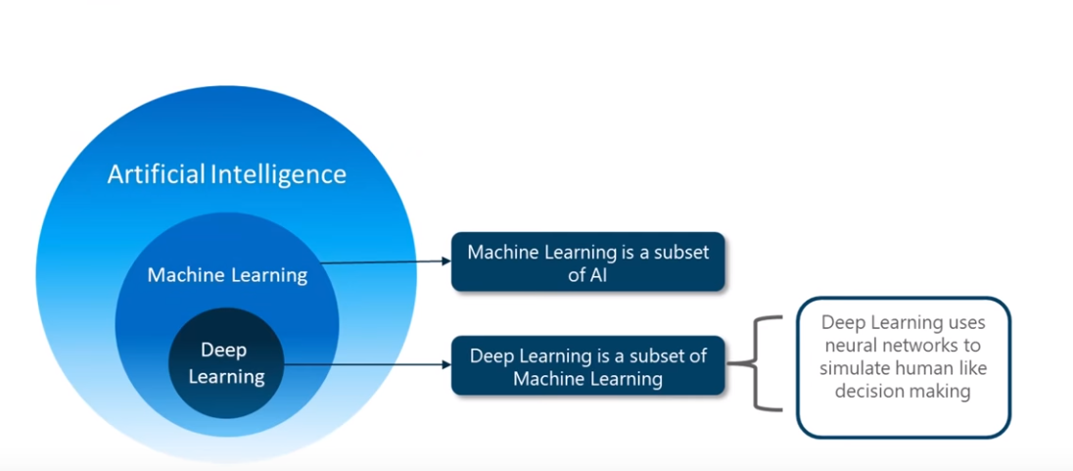

Slide 5
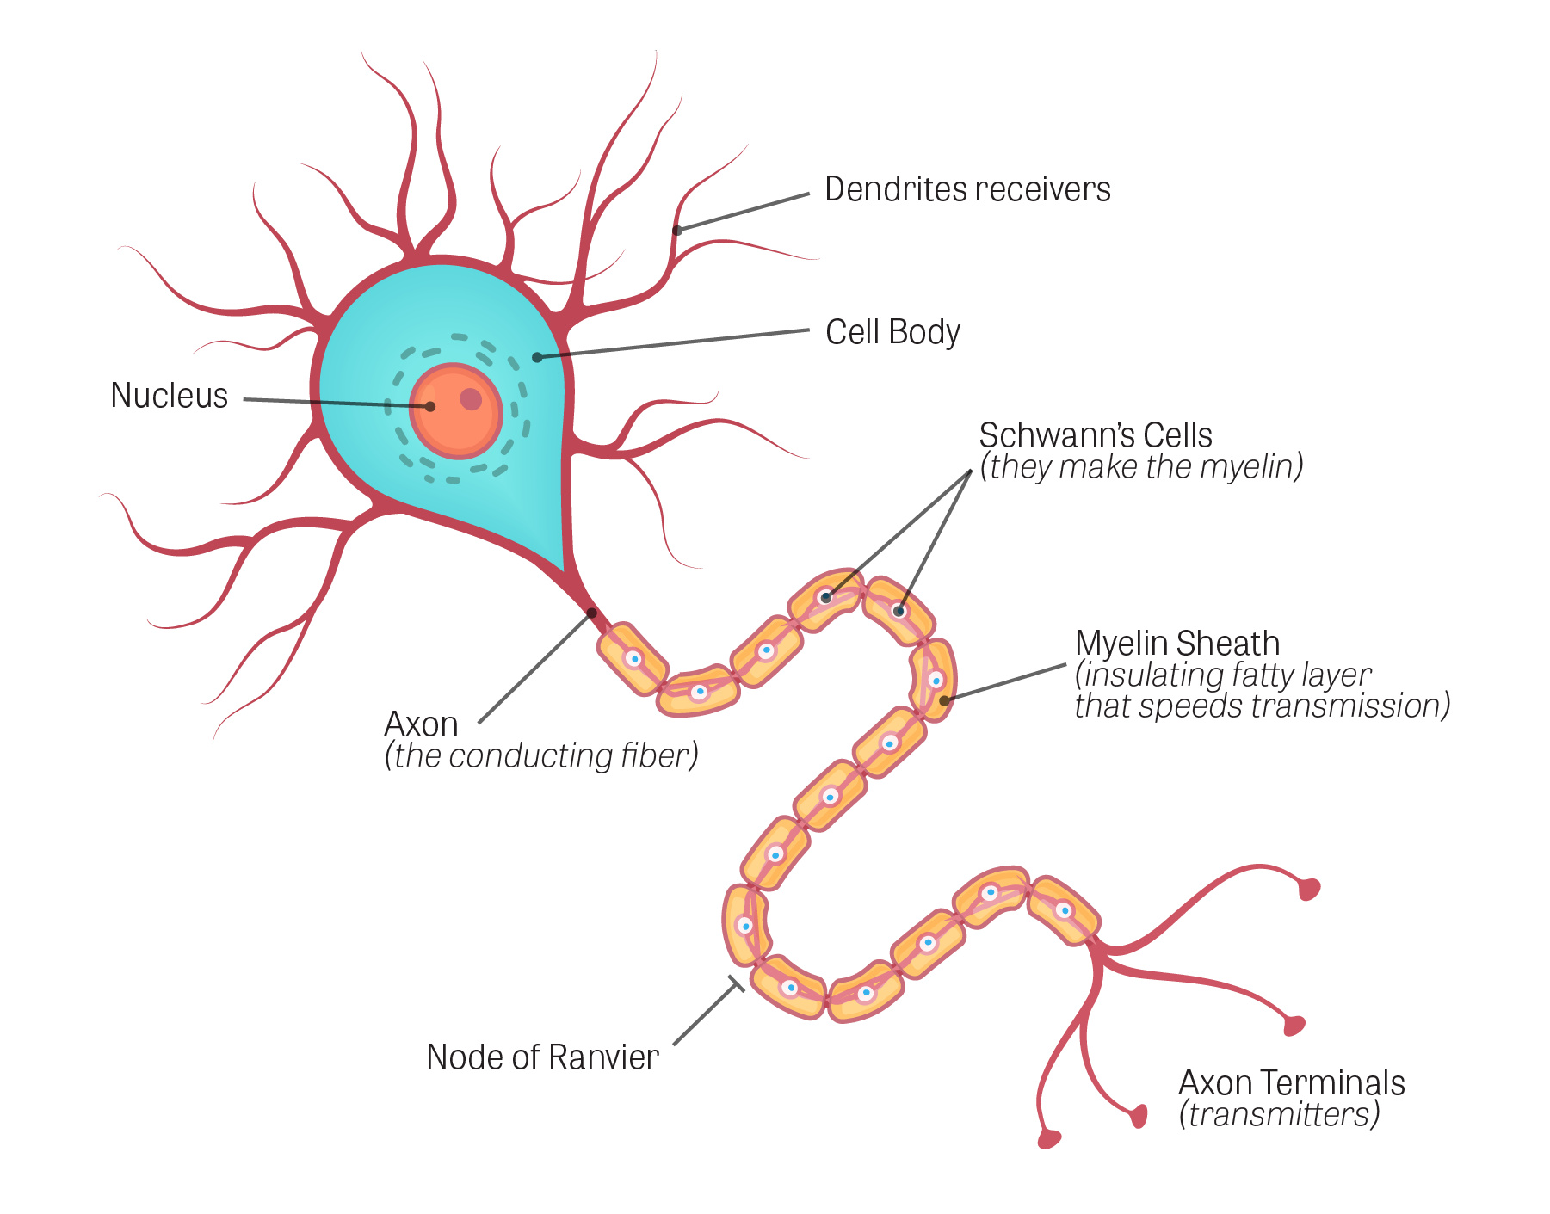
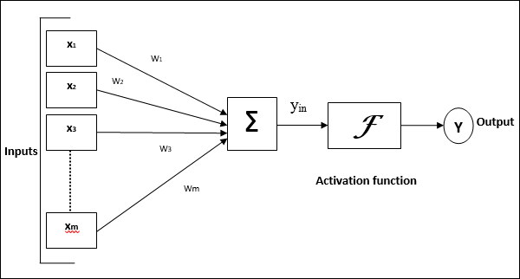

Slide 6
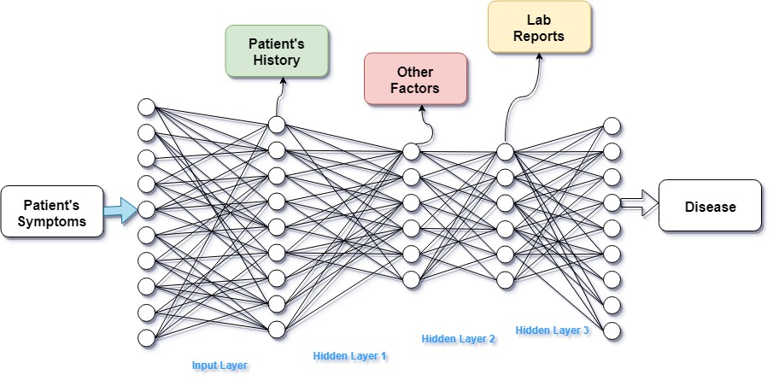

Slide 7
Base Paper :- “Medical Diagnosis System using Machine Learning”
Literature Survey:
Description :
The main objective is to design a medical diagnosis software using Artificial Intelligence and Neural Networks.
In the beginning they observed the current scenario of medical diagnosis system with different data mining techniques.
Later proposed an algorithm to predict the Swine Flu disease on several attributes.
Advantages:
They have observed the outcomes for machine learning algorithms such as Bayesian classification, Decision Tree, and compared it with the neural networks algorithms such as dynamic node creation(DNC) and feed-forward neural network construction.
The system is more reliable and faster than the conventional systems.
Disadvantage:
The problem statement only focuses on a single disease i.e. Swine Flu .
Each disease will have to have its on algorithm to be precise and accurate.

Slide 8
Paper 2: “From expert systems to machine-learned diagnosis model”
Description :
This paper presents a method to merge both approaches by using expert systems as generative models that create simulated data on which models can be learned.
Demonstrates that such a learned model not only preserves the original properties of the expert systems but also addresses some of their limitations.
This show how this approach can also be used as the starting point to combine expert knowledge with knowledge extracted from other data sources, such as electronic health records.
Advantages :
It includes the relationship between expert systems and stimulated data.
The extraction of data from the knowledge base to obtain the learning data.
Disadvantages :
T

Slide 9
Paper 3:- “Machine Learning applied to the detection of retinal blood vessels”
Description :
This paper details the process and results of an attempt to improve upon the accuracy of retinal image segmentation to aid doctors in diagnosing diseases of the eye using supervised (support vector machine) and unsupervised (modified k-nearest neighbor) machine learning algorithms.
Advantages:
Simplifies the method of determining the segmentation of the circulatory system in the eye as it is difficult for doctors as the task of distinguishing blood vessels by simply observing retinal images has proven to be challenging.
It is capable of detecting wide range of diseases using several morphological features of retinal veins and arteries.
Disadvantage:
The implementation of the model is done using only two algorithms i.e. SVM and modified KNN.
Will require great number of dataset for the model to be more accurate and narrow down the disease.

Slide 10
Paper 4:- “A Study on Machine Learning algorithm in medical diagnosis”
Description :
The main objective is to design a medical diagnosis software using Machine Learning algorithms.
The algorithms used are Support Vector Machine, Naïve Bayesian, Random Forest etc.
Advantages:
The paper covers the ML algorithms used for several diseases such as diabetes, liver failure, autism identification, heart problems, etc.
It is completely data driven and have the capability of examining the large amount of data.
These algorithms are more accurate and does not prone to errors.
Disadvantage:
The statistical models cannot handle categorical data with missing values and large data points.

Slide 11
Paper 5:- “Title”
Description :
I
Advantages:
The.
Disadvantage:
The

Slide 12
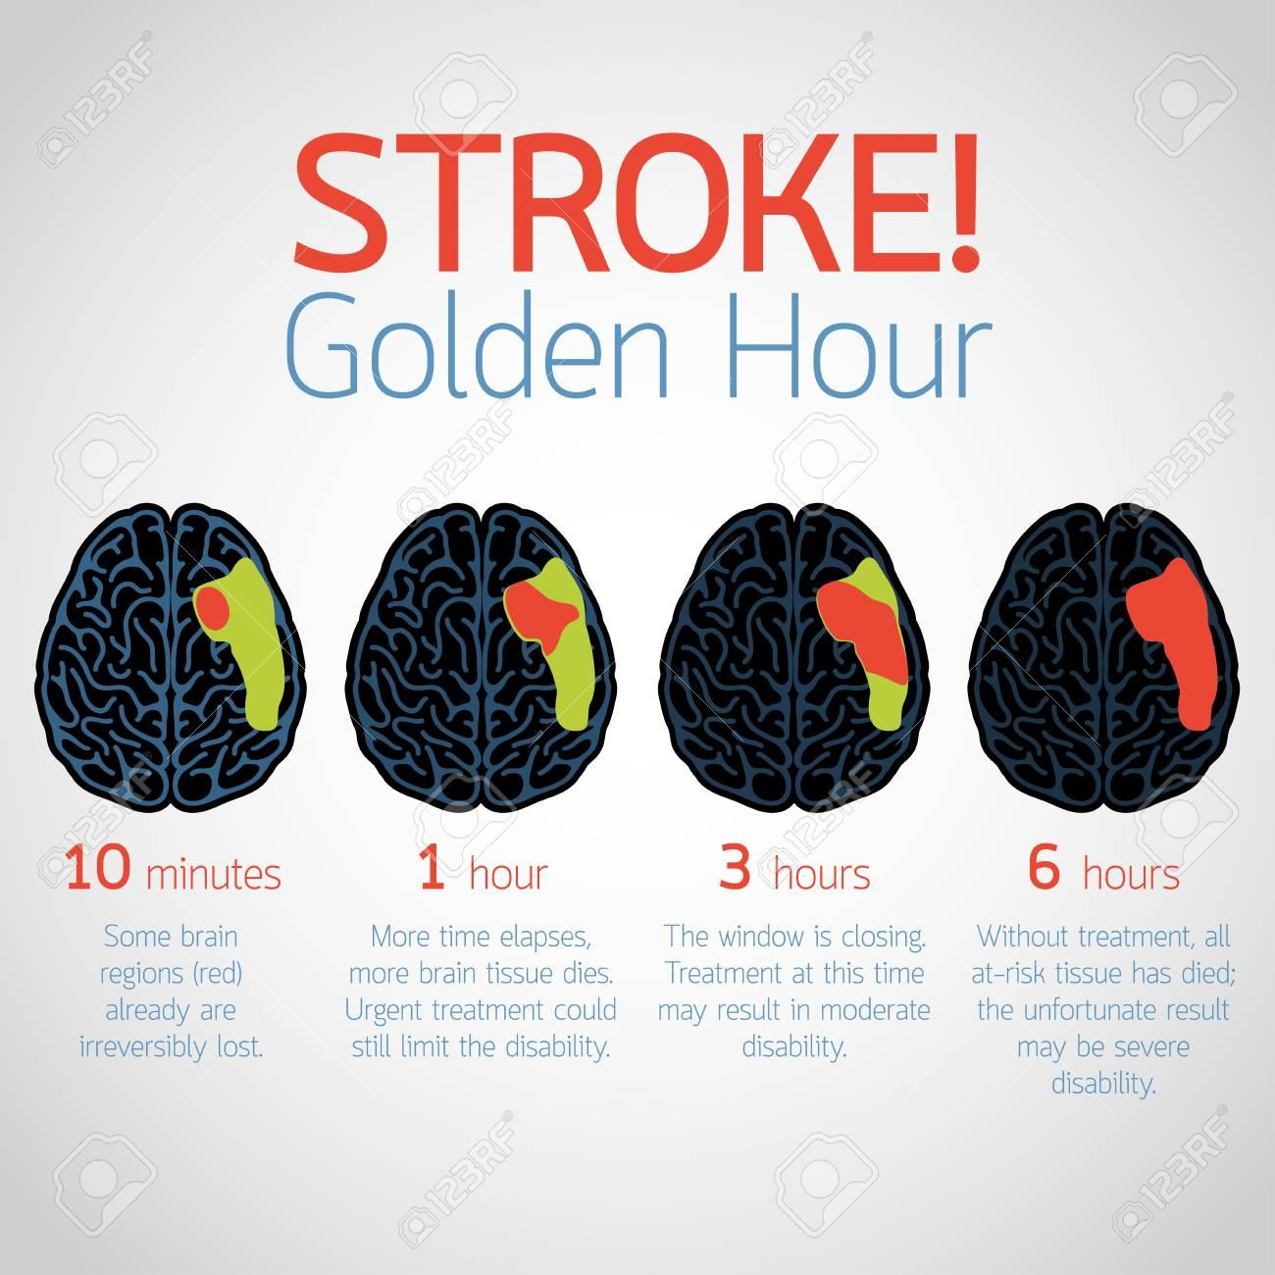
Motivation
The poor rate of diagnosing, finding
the accurate disease and commencing
the treatment.
Negative impact on diagnosis due to
the lack of knowledge and loss of
information.
utilizing the golden hours for
diagnosing rather on treatment.

Slide 13
Existing System
Describe the existing system

Slide 14
Problem Statement
Diagnosing the patient and treating for the permanent cure has been challenging forever. Patient would have undergone irreversible damage to his health condition even before identifying the actual disease he has been suffering from.
Thus permanent cure can be achieved by a patient when he is diagnosed and treated right within the golden period of the disease.
Developing an automated system for diagnosing the patient provided with the patient’s conditions, test results and history and listing out accurately the most appropriate diseases causing the symptoms can improve the rate of diagnosing drastically, increase the probability of permanent cure and thus saving millions of life.

Slide 15
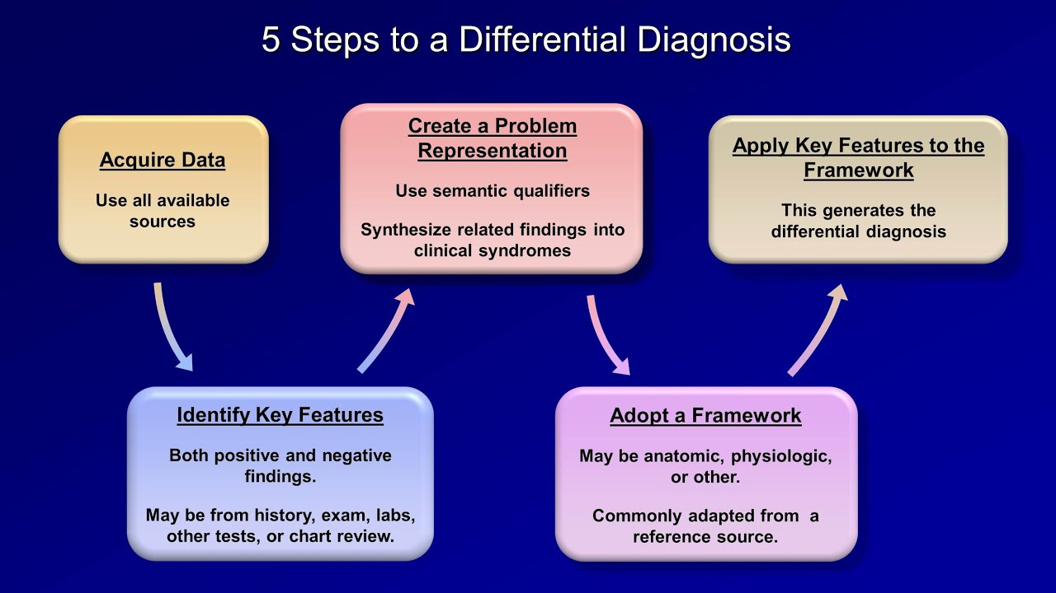
Design

Slide 16
Requirements Specification
Hardware Components:
PC with 8gb RAM
i7 processor
Software Requirement:
Windows 10
Python
Anconda
Jupyter Notebook
Tensorflow
Keras

Slide 17
Bibiliography
[1] Murali Ravuri, Anitha Kannan, “From expert system to machine-learned diagnosis models, Proceedings of Machine Learning Research , Machine Learning for Healthcare,85,1–16, 2018.
[2] Dhaval Raval, Dvijesh Bhatt, “Medical diagnosis system using Machine Learning, International Journal of computer science , Machine Learning for Healthcare, Volume 7,1–6, 2016.
[3]Dr A N Jayanthi, Ms D Pavithra, “A Study On Machine Learning Algorithm In Medical Diagnosis”, International Journal of Advanced Research in Computer Science, Volume 9,No 4, July-August 2018.
[4] Shaik Razia,N Vamsi Krishna,”A Review On Disease Diagnosis Using Machine Learning Techniques” , International Journal of Pure and Applied Mathematics, Volume 117 No. 16 2017, 79-85.
[5] Alex Yee,” Machine Learning Applied to the Detection of Retinal Blood Vessels, Stanford University.

Slide 18
Thank You

Slide 19
Q & A

